Slide 1

Paramount Practicum Project
April 12th, 2024
Jingyi Huang, Jiatong Song, Yifei Wang, Lin Yeh, Wenchun Zhang

Slide 2





Meet the team
Jingyi Huang
Jiatong Song
Yifei Wang
Lin Yeh
Wenchun Zhang
P2

Slide 3



Detecting the content interactions can help Paramount make strategic exploitation decisions
Although content interactions exist, a solution to detect them has not yet been found
A systematic method to detect consistent interactions between shows
Inform and therefore make content exploitation decisions
Challenge
Method
Opportunity
P3

Slide 4
The insights of content interaction detection have positive impacts on various business divisions at Paramount
Division | Action
Contents Production | Optimize user engagement through refine production cycle and strategies
Contents Marketing | Identify personalized marketing opportunities and foster content collaboration through cross-promotion to enhance user retention
Platform Management | Improve user acquisition by improving content discovery and recommendation algorithms to drive deeper market penetration
Contents Exploitation | Explore potential opportunities for content partnerships and expansion into new platforms to unlock growth potential and generate revenue streams
P4

Slide 5
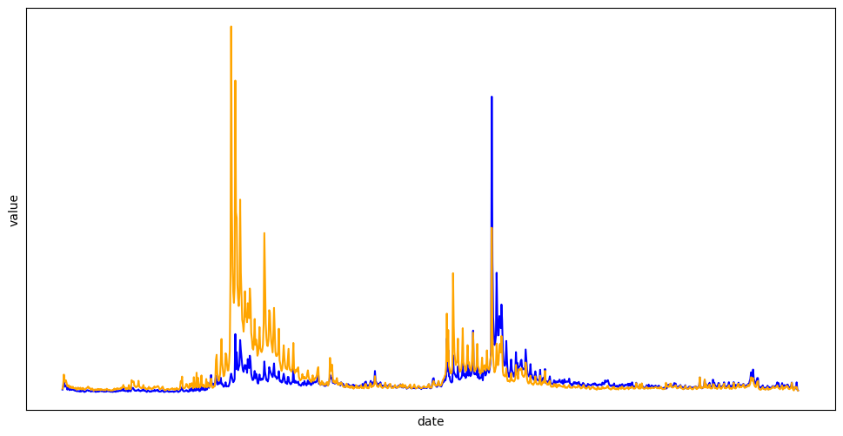
14 pairs of shows exhibit high similarity, enhancing viewership acquisition or viewership retention
Show Pairs |  | Similarity
B | D | 0.66
C | D | 0.65
A | D | 0.64
A | C | 0.61
D | E | 0.57
A | B | 0.56
J | K | 0.55
E | F | 0.54
B | H | 0.54
C | H | 0.53
A | H | 0.53
D | I | 0.52
B | C | 0.51
L | O | 0.50
Value of high similarity pair
Show B
Show D
P5

Slide 6
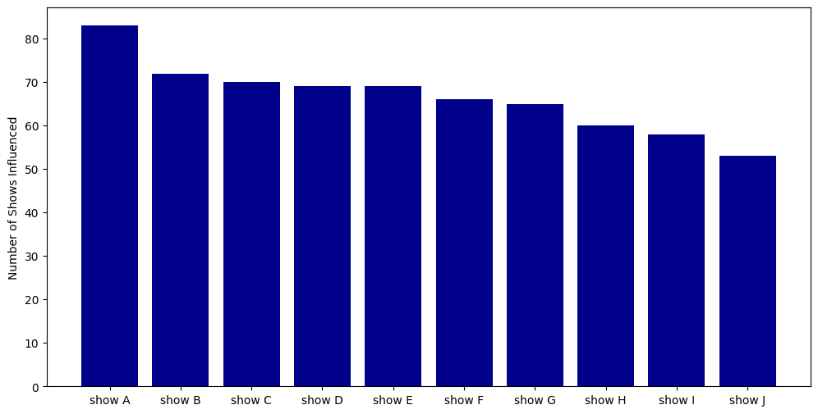
Super boosters are improving the performance of more than one show
Highest number of shows influenced by one show
P6

Slide 7
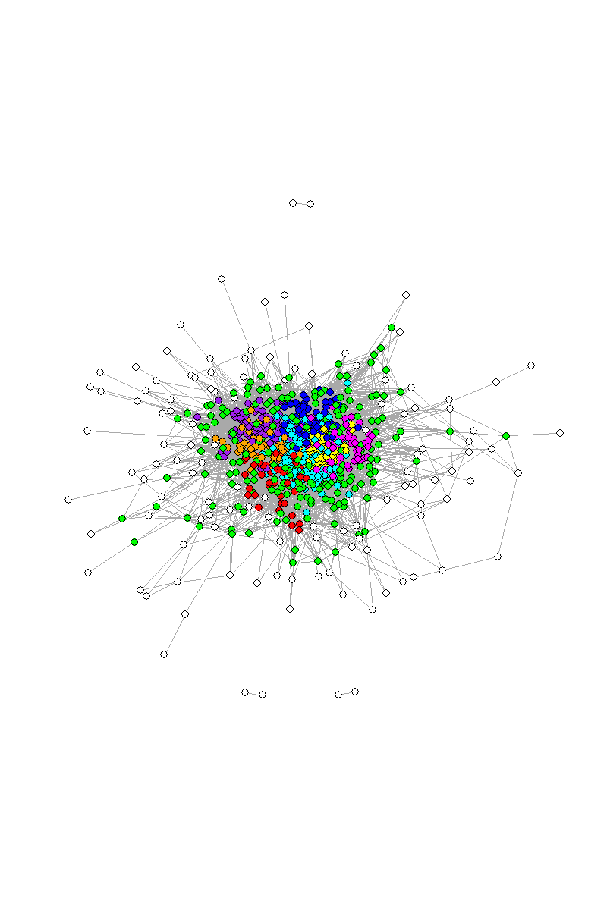
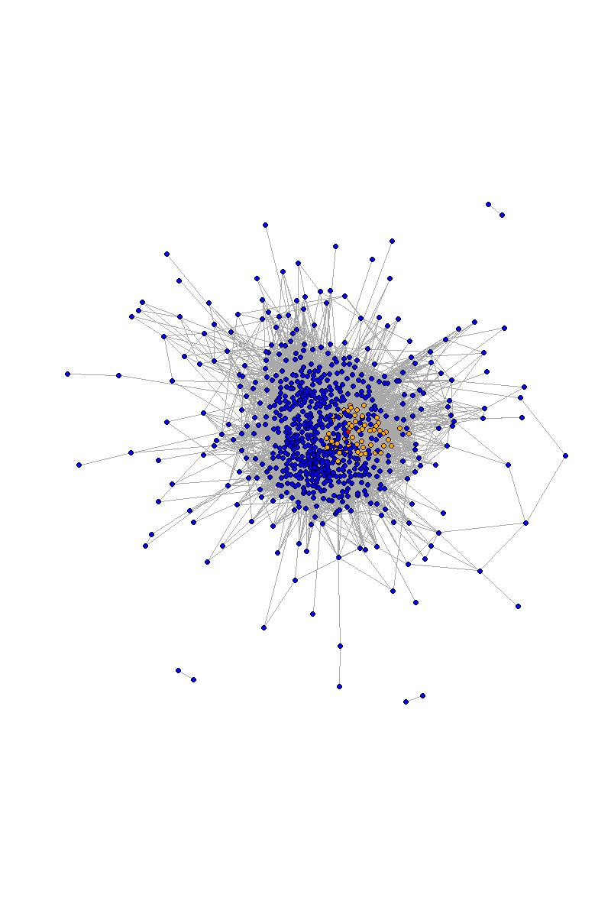
Contents can be grouped based on their similarity with one another and a super booster can be identified within each cluster
Nine clusters based on similarity
One of the cluster and its super booster
P7

Slide 8
Content interactions process covers anomaly detection, trend removal, identifying correlated pairs and clustering
Contents Interactions Detection solution
Anomaly Detection
Remove Global Trend
Identify Correlated Pairs
Cluster Pairs
Z- score Threshold
Facebook Prophet Model
Seasonal Decomposition
Median list across all shows
Jaccard Similarity
KS Statistic
Slope of cumulative curve
Network Analysis
P8

Slide 9



Future business applications and thinking ahead with additional data resources
Future promotion campaigns can focus on super shows, realizing expanded reach and maximizing marketing impact with the same resources
Cross-promote correlated shows at the household level, enabling content to reach new audiences and provide valuable content to existing customers
Design phase promotions to enhance viewership by optimizing the scheduling of same-cluster contents
P9

Slide 10
Paramount can mitigate potential risks associated with the implementation of the Contents Interactions Detection solution
Risks | Mitigation Plan
Increase cross-promotion: Competitive Conflicts | Develop a strategic cross-promotion plan that strikes the right balance between exposure and exclusivity
Reduce cross-promotion: Failing to capture the attention of not overlapped audiences | Segment the target audience based on their interests, preferences, and viewing habits to tailor cross-promotion efforts effectively
Licensing: Losing customers | Detailed cost and benefit analysis on the decision
P9

